Slide 1
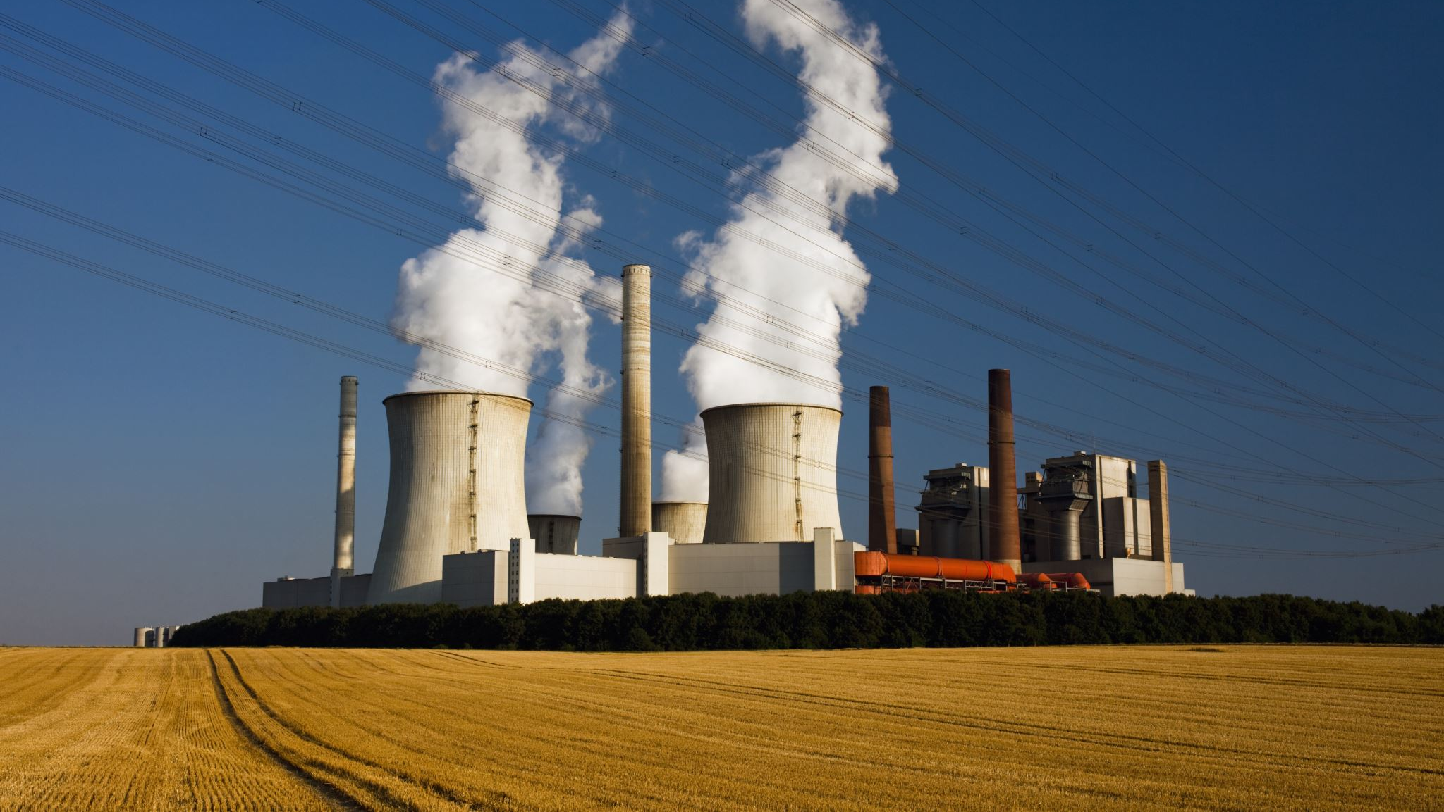
Clean Coal Technologies
By: Jihad Jundi & Aya Sabe Ayoun

Slide 2
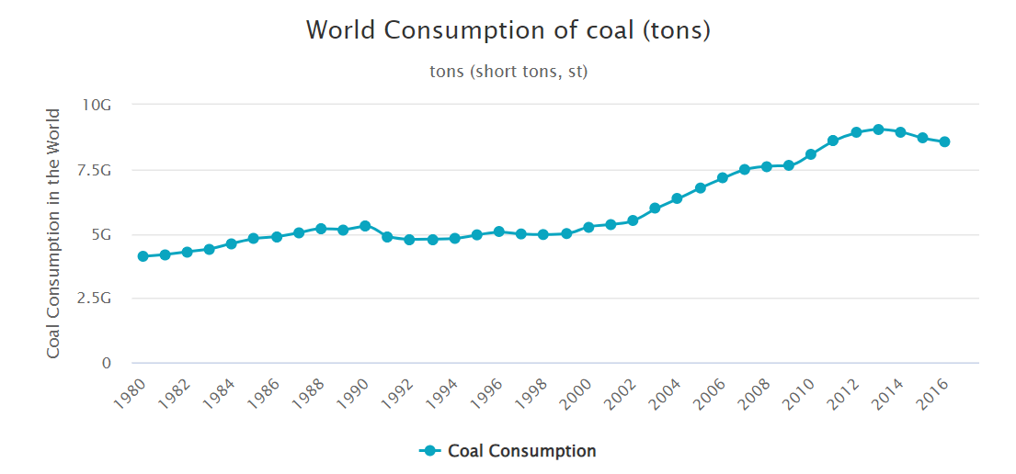
History of Coal:
Coal has been used as a fuel but wasn’t fully utilized until the start of the industrial revolution at the start of 19th century due to the invention of the steam engine.

Slide 3

Composition
Coal is formed mainly of :
Carbon
Hydrogen
Sulfur
Oxygen
Nitrogen

Slide 4
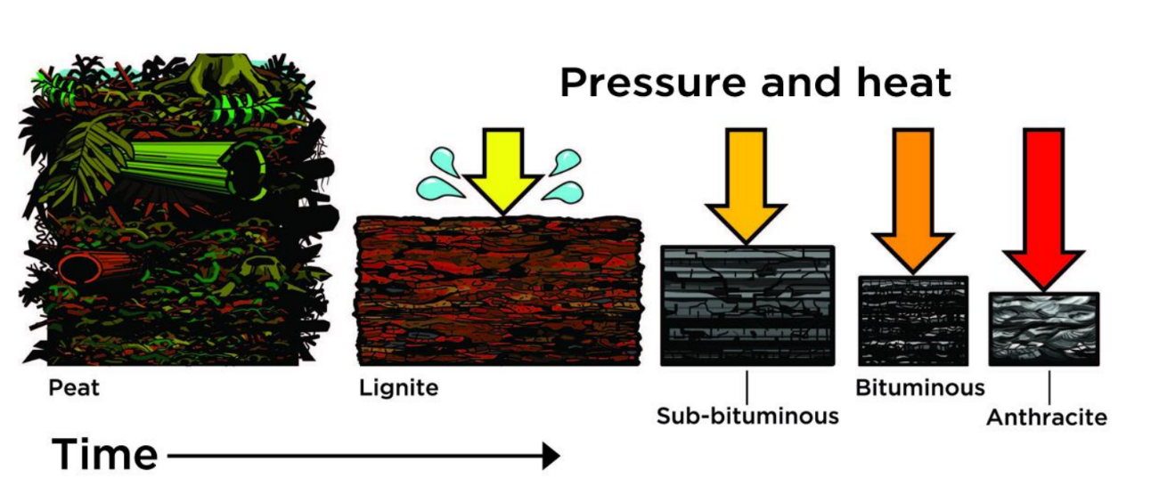
Formation:
Dead Plant
Turf
Thermal Energy
+
High Pressure
Coal

Slide 5
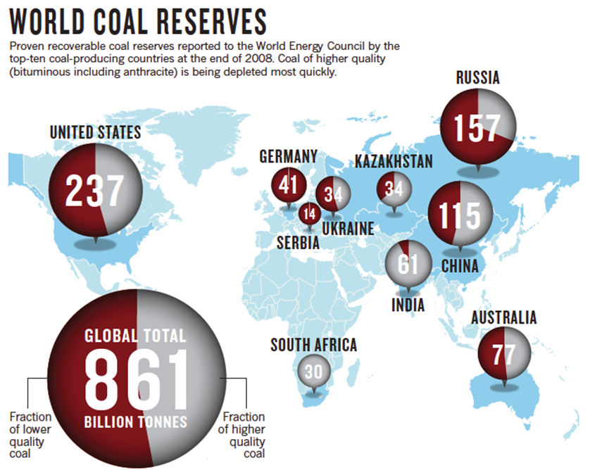
Availability and Consumption:
Most abundant fossil fuels
Has more than 1 trillion tons of reserves and 8.5 billion tons of consumption.
US is considered the country with highest reserve followed by Russia and China.

Slide 6
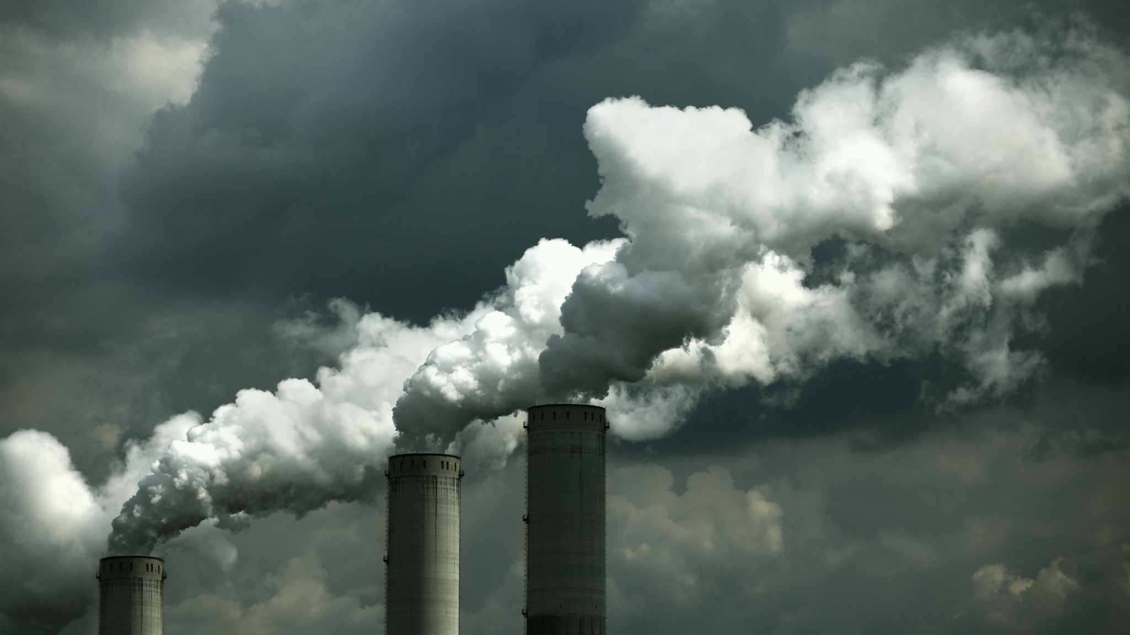
CO2 and Green House Emissions:
Emits highest level of CO2 compared to all other energy sources. (30% of total CO2 emissions)
It releases several toxins including mercury, ash, sulfur when released into the air.
These toxins effect pollution, health and climate change severity.
It leads to the death of 465000 individuals yearly.

Slide 7
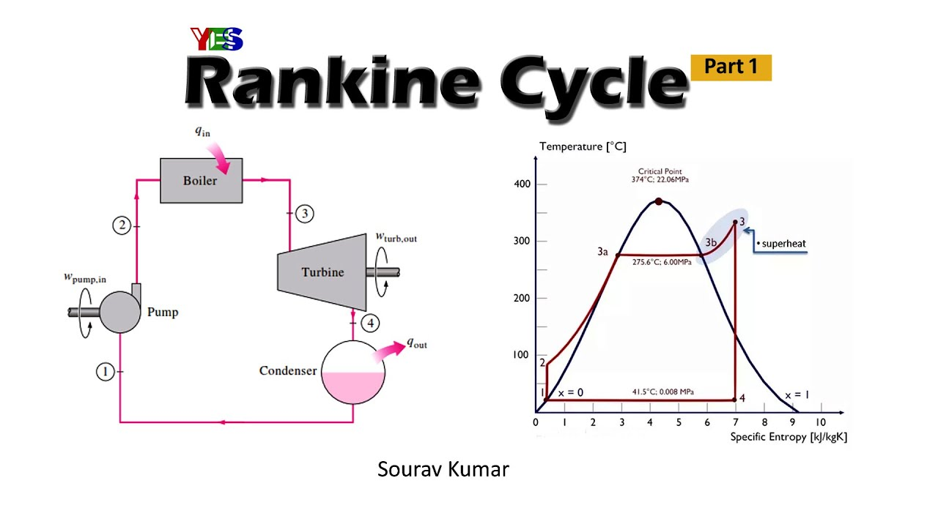
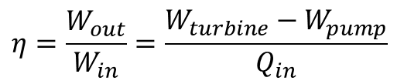
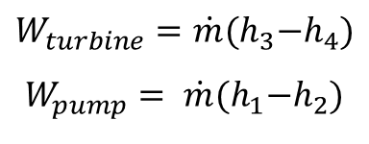
Operation of Coal Power Plants:
Rankine Cycle:
$$η=\frac{W_{out}}{W_{in}}=\frac{W_{turbine}−W_{pump}}{Q_{in}}$$
$$W_{turbine}=\dot{m}{(h}_{3}−h_{4})$$
$$W_{pump}= \dot{m}{(h}_{1}−h_{2})$$

Slide 8
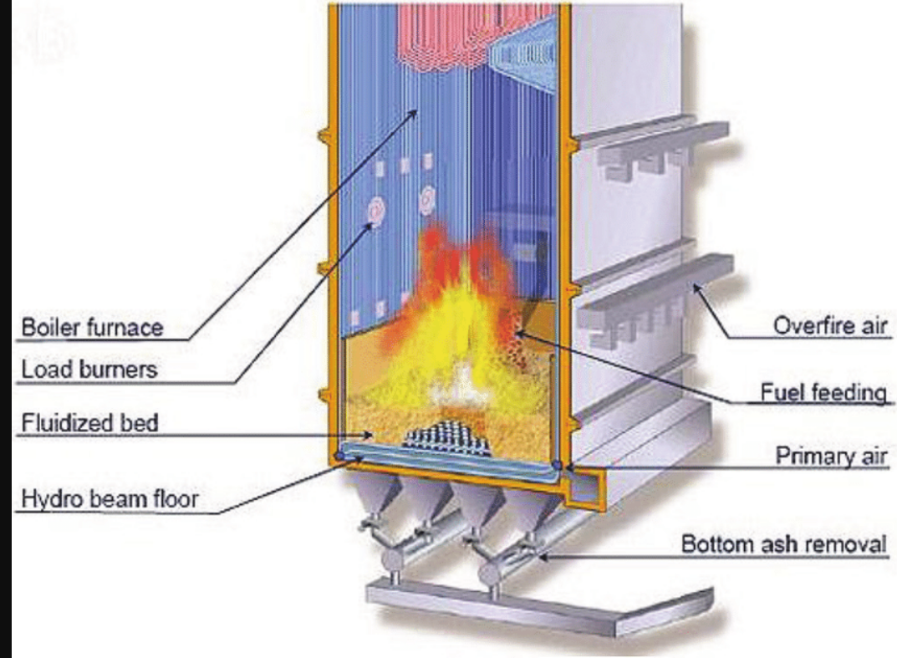
Coal Furnace
Consists of water running through tubes that passes through fire which leads to rise of temperature.
After the burning, remaining ash is collected and removed from the bottom of furnace.
There should be a sufficient supply of air to have enough oxygen for the combustion process.

Slide 9
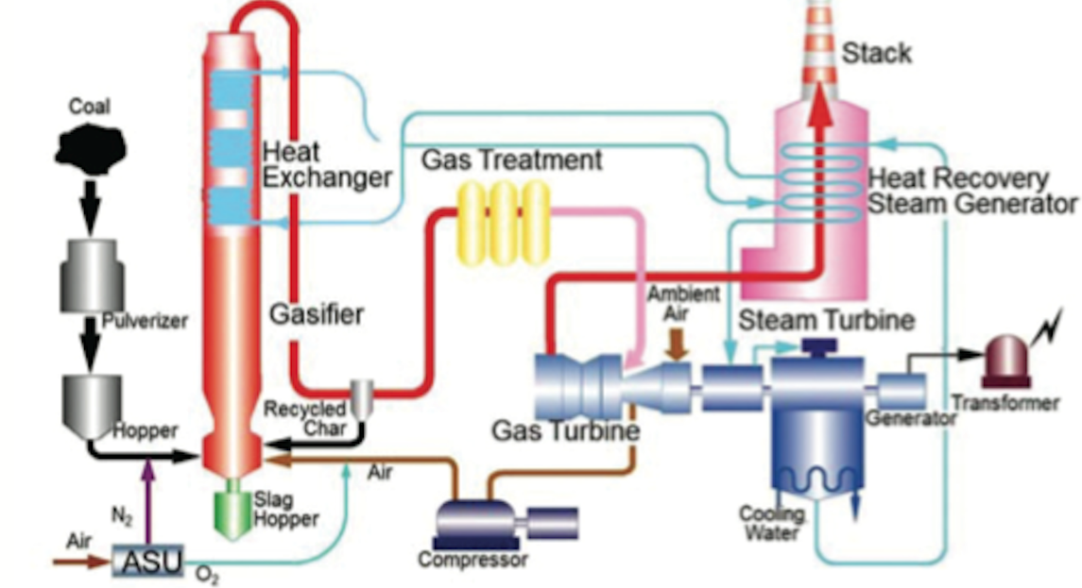
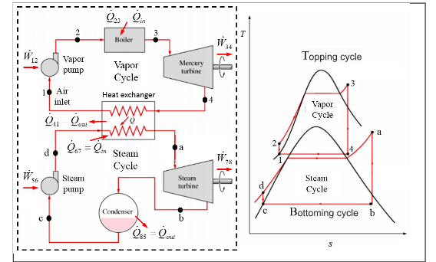
Integrated Gasification Combined Cycle:
IGCC increases the thermal efficiency of the coal power plant and decreases level of CO2 emissions by half.
It gasifies coal to produce syngas (mixture of hydrogen and carbon monoxide), which is then burned, and the products are passed into the gas turbine generating electricity.
A heat recovery steam generator is used at the exhaust of the gas turbine to increase the temperature of the steam fed to the steam turbine generating more electricity.
This increase in thermal efficiency is due to the combined power generation of Rankine and Brayton cycles.
It’s 35% more expensive than Rankine cycle powered coal power plants powered by Rankine cycle.

Slide 10
Gasification Process:
Coal is fed into gasifier using air as a gasification agent.
Clean gas is inputted into the gas turbine combined cycle.
This results in less power consumption for oxygen production resulting in higher net thermal efficiencies.
It produces syngas, which is much cleaner than coal since its sulfur and dust free.

Slide 11
Why Do We Need Regeneration Methods:
Coal has a high concentration of trace elements so, during combustion, ashes enriched 3 to 10 times with trace elements are produced.
Arsenic, a chemical compound associated with sulfur, is released from the structure of coal, and tends to be adsorbed into the small ash particles, increasing its availability from 25% in coal to 70% in ash.
A lot of toxic metals were associated with coal combustion by-products, the most concerning ones are Molybdenum and Arsenic.
Due to this problem, new methods for cleaning coal need to be investigated. One of these methods is carbon capture and separation.

Slide 12
Carbon Capture and Separation:
Coal gets burned and kept in its powder form.
It’s then mixed with pure oxygen to ignite the mixture making CO2 the main constituent of the exhaust gasses.
This exhaust mixture gets stored underground or in other storage systems that are very dangerous and expensive.
It can be more economical if this stored mixture gets used in industrial applications.

Slide 13
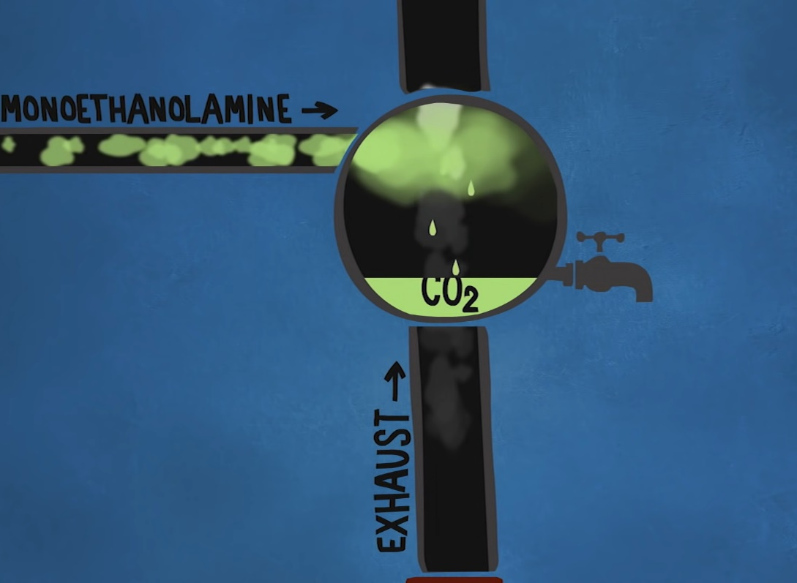

Alternatively, we can mix the exhaust gases with Monoethanolamide, which upon reacting with CO2 transforms into liquid allowing the storage and pumping of CO2:
$$CO_{2}+2RNH_{2 }→ {RNHCOO}^{−}+RNH_{3}^{+}$$

Slide 14
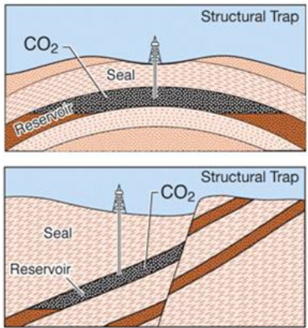

Methods of CO2 Storage:
1. Structural Trapping:
traps the largest amount of $CO_{2}$ in rocks physically.

Slide 15
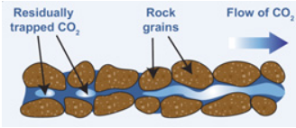

Methods of CO2 Storage:
2. Residual trapping:
traps $CO_{2}$ in the pores between rock grains.

Slide 16
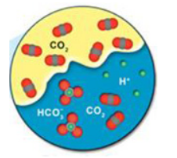

Methods of CO2 Storage:
3. Solubility trapping:
injected $CO_{2}$ will be absorbed into the brine water between the pores within the rocks

Slide 17
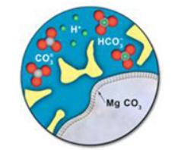

Methods of CO2 Storage:
4. Mineral trapping:
occurs when the $CO_{2}$ dissolved in the rocks’ brine water reacts with the minerals found in these rocks

Slide 18
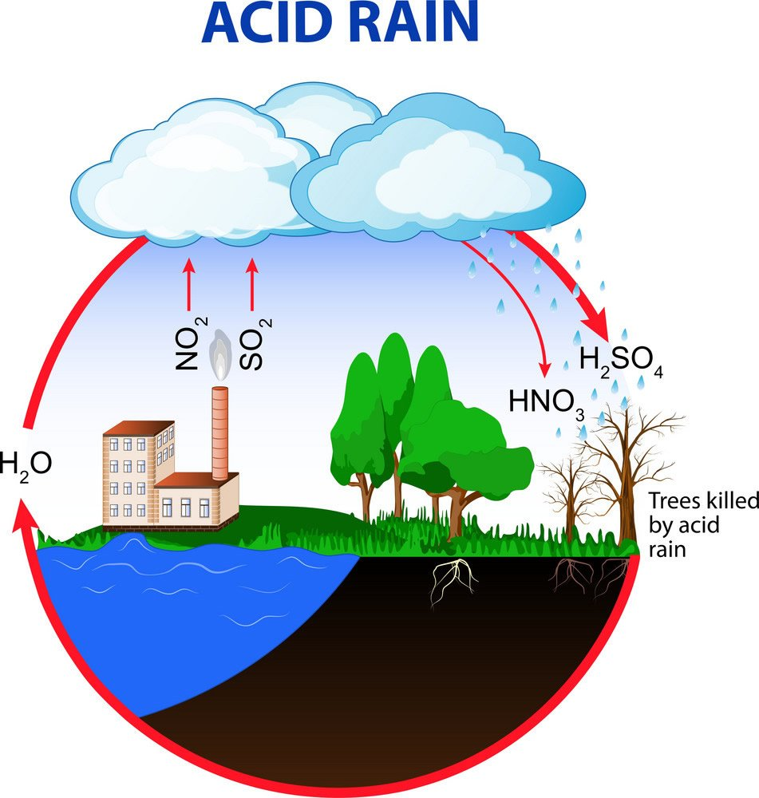
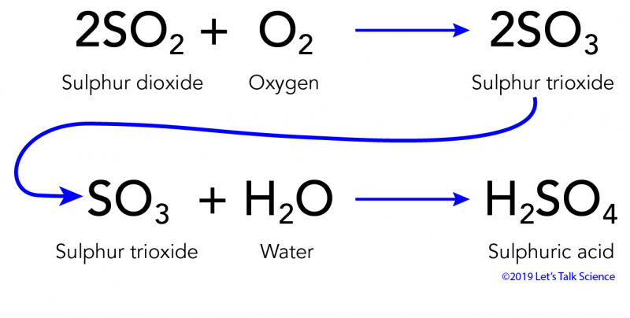
Sulfur Removal
Combustion of Sulfur leads to the formation of acid rain.
Chemical, physical and biological methods.
Powderizing coal and running water through it, resulting in sulfuric water.

Slide 19

Coal vs Renewable Energy
Which type of energy production should we use?

Slide 20

Financing needed to turn from coal to other energy sources
cost/kWh =0.167
G of CO2/kWh=1011.5
Solar:
cost/kWh =0.06
G of CO2/kWh=50
Hydro:
cost/kWh =0.85
G of CO2/kWh=24
Wind:
cost/kWh =0.053
G of CO2/kWh=11
Coal:

Slide 21
Global Distribution of Percentage Cost for Eliminating Coal Power Generation:
The global cost of eradicating coal power generation is about $29 trillion.

Slide 22
Limitations of Renewable Energies:
Solar energy: needs a significant exposure area to solar radiation to produce large amounts of power.
Hydropower: needs high mountain with water reservoirs or very fast flowing rivers limiting the capability of producing large amounts of energy
Wind energy : very high noise and visual pollution it cases, the intermittency of it, due to the variability of wind speeds.

Slide 23


Conclusion:
IGCC coal power plants are too expensive to use.
Using carbon capture and storage methods without reusing the captured $CO_{2}$ is also very costly.
Coal power plants are not the cheapest power generation method available and that other fossil fuels such as natural gas are a cleaner option.
Removing sulfur and ash is common in coal power plants and is added to most coal power plants today.
It is recommended to use coal power plants with carbon capture and storage technologies, while simultaneously using the carbon dioxide in industrial use by the chemical or oil industry.
We do not recommend the usage of IGCC coal power plants, because it is very expensive, although it increases the thermal efficiency of the system.
In the case of being able to introduce different power generation systems, it is recommended to either incorporate natural gas or renewable energies based on which is less expensive for the region. However, if our main goal is to minimize the carbon emissions, we would like to use renewable energies completely.

Slide 24
Thank you!

